Slide 1
Retaining existing trees on residential development sites in Bristol
Vassili Papastavrou, Secretary Bristol Tree Forum
Trees and Design Action Group Meeting Working with Trees on New Developments
14 September 2022

Slide 2
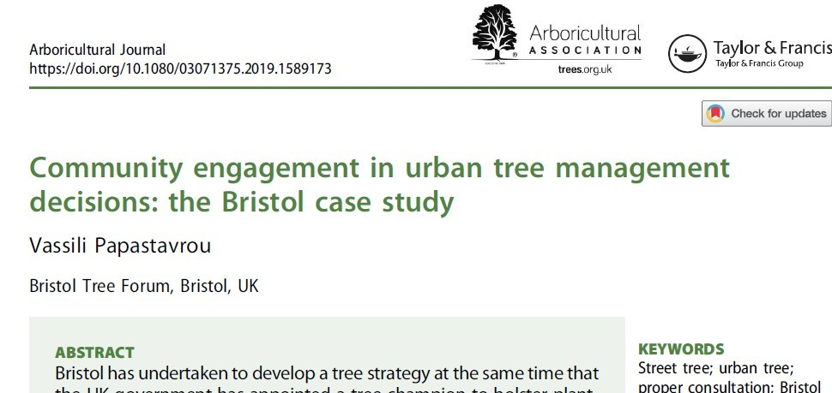
The Bristol Tree Forum
Was set up in 2008 to facilitate community engagement in Bristol’s tree management decisions
Has an active website, blog and social media presence.
The sister site Trees for Bristol has mapped all Bristol’s trees

Slide 3
Planning policies
Local Planning Policy BCS9:
“Individual green assets should be retained wherever possible and
integrated into new development.”
Local Planning Policy DM17
“All new development should integrate important existing trees”
The Bristol Tree Replacement Standard – unintended consequence is that it seems to facilitate removal of trees on development sites
NPPF Mitigation Hierarchy (Para 180a) – cascading decision process
(Avoid → minimise → remediate →compensate)
……But the pressure to build houses regardless seems to over-ride all other planning policies in Bristol. We are losing large form trees all over Bristol.

Slide 4
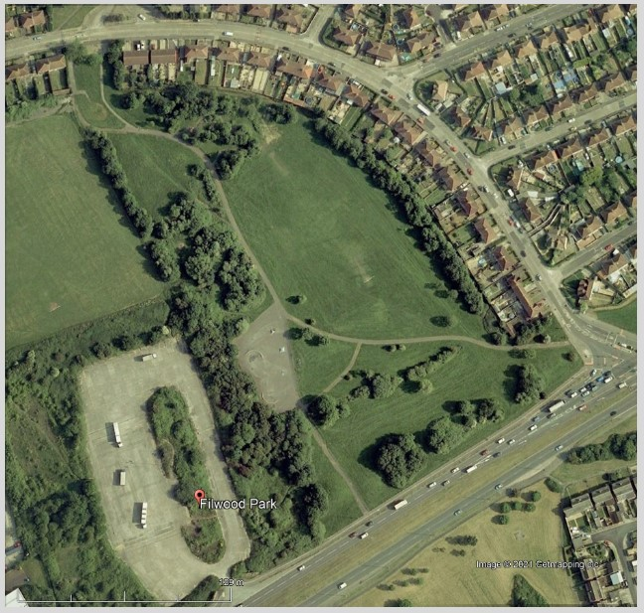
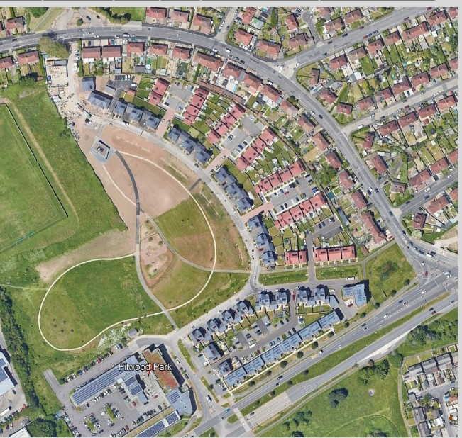
Filwood Park….

Slide 5
Newfoundland Road

Slide 6
Lower Ashley Road

Slide 7
Hengrove Leisure Park
All the plane trees in this carpark (and many others – a total of 277 trees) will be removed to build houses on the carpark & elsewhere on the site

Slide 8
Changing the Culture
Bristol Tree Forum provides detailed comments on important planning applications but by the time there is a formal application it is too late. So, the comments are ignored
Planning Committee members are mostly unaware of Bristol’s Green Planning Policies and the opportunities to build better by retaining existing trees
Retaining existing trees is controversial and instead people (and the media) prefer to focus on planting new trees on the outskirts of the city
We’ve tried writing blogs….

Slide 9
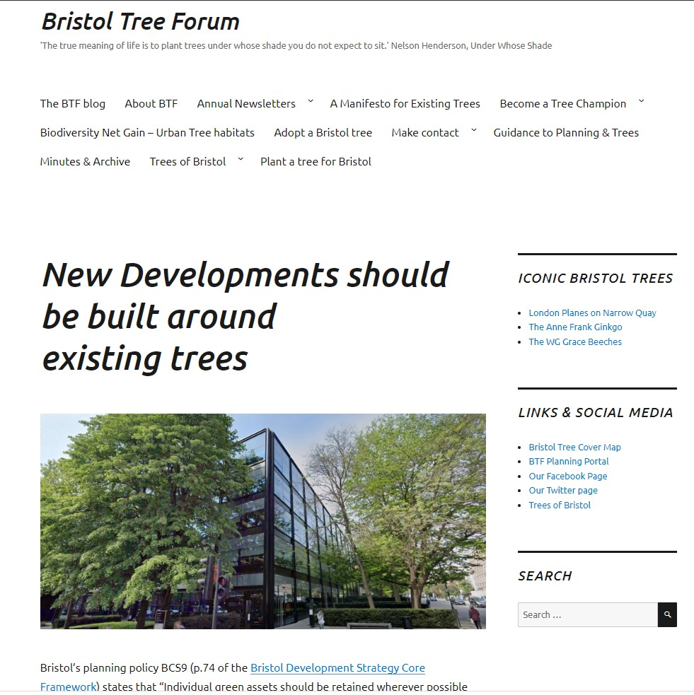

Slide 10
Some Questions…
Why do some LPAs require developers to build around existing trees but not others? How does one change the culture within a Local Planning Authority?
Is BS5837 Tree Categorisation still fit for purpose in the climate emergency?
Can we gather case studies of good examples of residential housing?
Can the same housing density be achieved?
What are the additional costs/value of housing?
Foundations on shrinkable soils (NHBC Ch. 4.2)

Slide 11
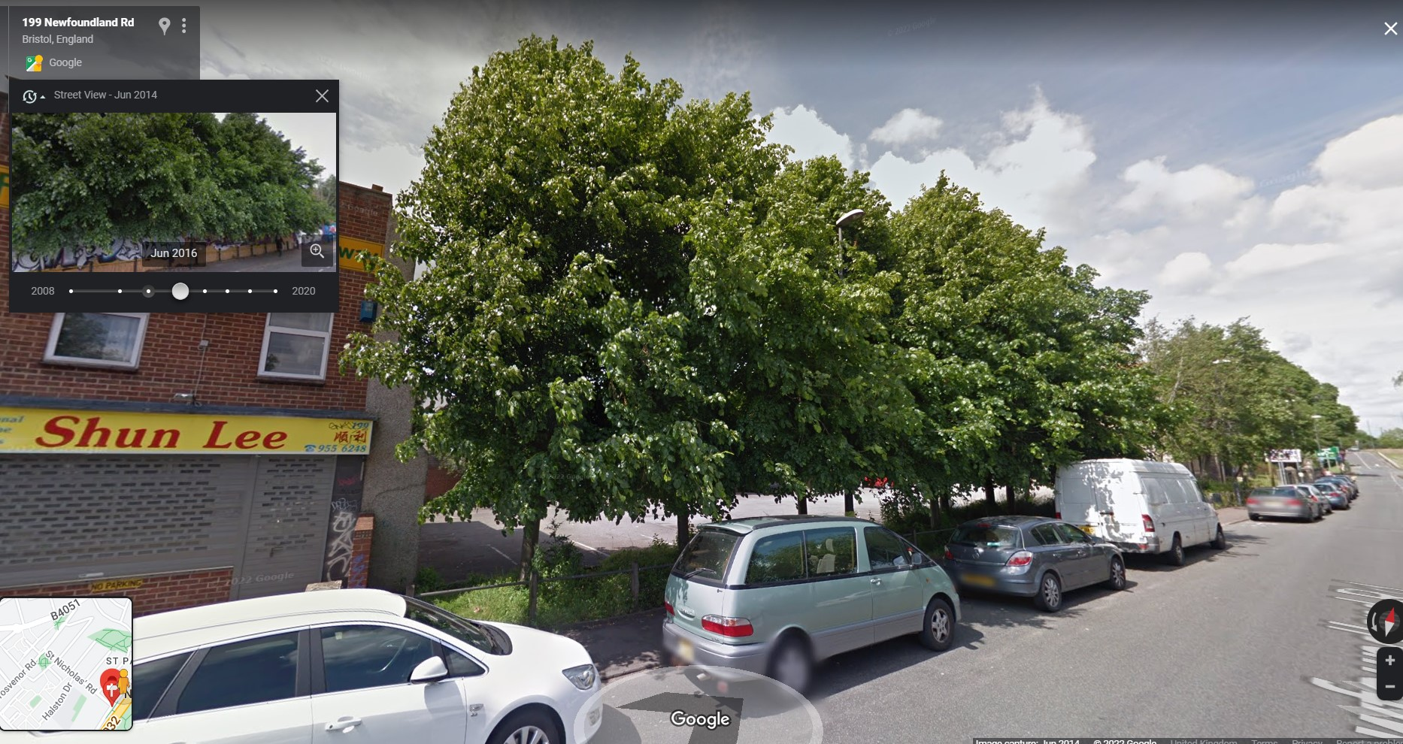
Jam Today
Retaining existing trees brings immediate benefits

